Slide 1

RECURRENCE &
DIVIDE-AND-CONQUER
Prof. Zhenyu He
Harbin Institute of Technology, Shenzhen

Slide 2

OUTLINE
Sort Example and Asymptotic Analysis
Recurrence and Divide-and-Conquer
Three recurrence solving methods
Substitution method
Recursion-tree method
Master method
Divide-and-Conquer example
Big Integer Multiplication
Strassen Matrix Multiplication
Chessboard Cover
Order Statistic

Slide 3
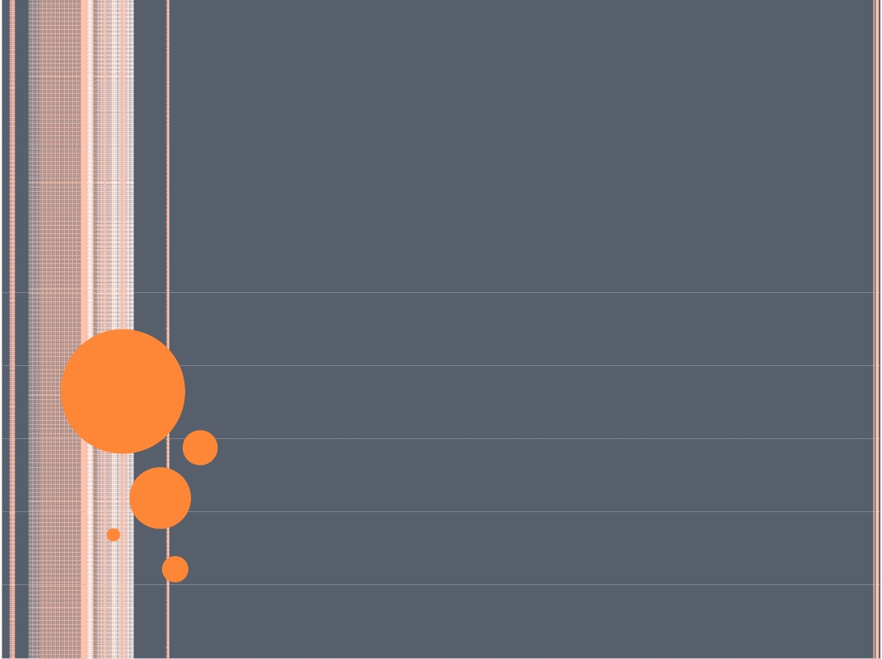
SORT EXAMPLE AND
ASYMPTOTIC ANALYSIS

Slide 4
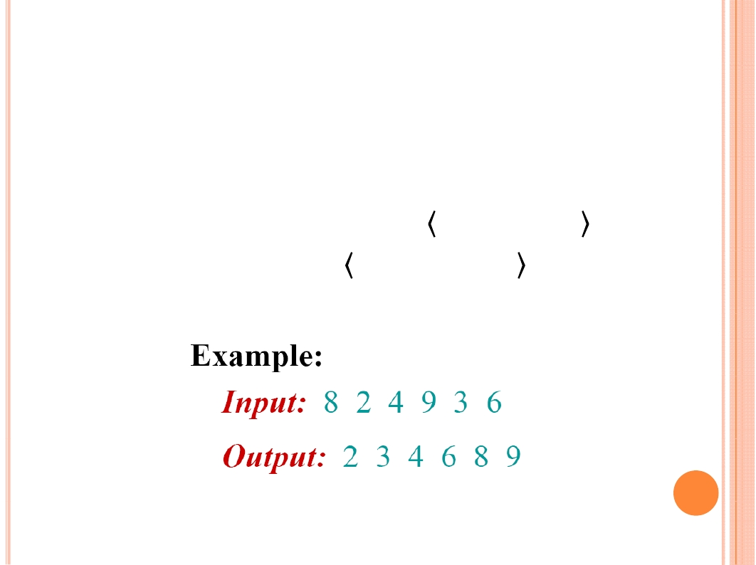
SORTING PROBLEM
Description:
Input: sequence of n numbers a1, a2, …, an .
Output: A permutation a'1, a'2, …, a'n such that
a'1 ≤ a'2 ≤ … ≤ a'n .

Slide 5
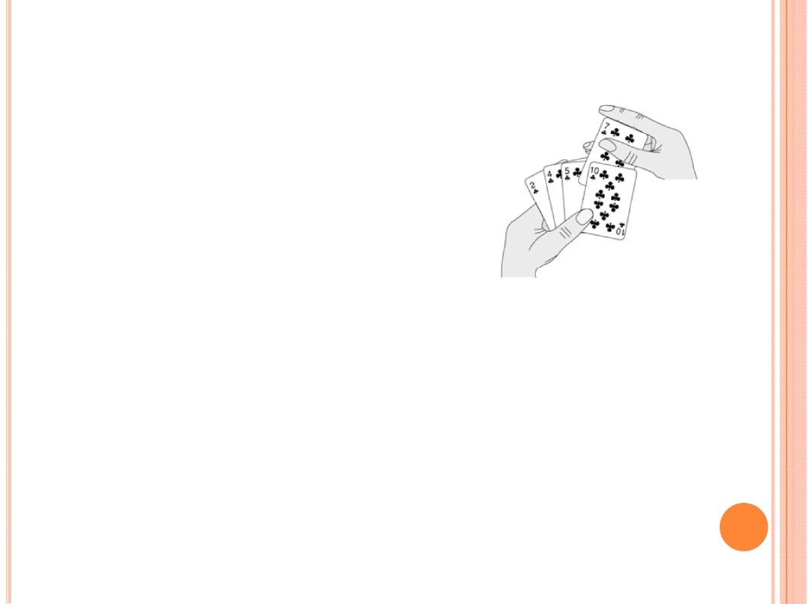
INSERTION SORT
Pseudocode
InsertionSort (A, n)
for j ← 2 to n
do
Insert A[ j ] into the sorted sequence
A[1 .. j - 1].

Slide 6
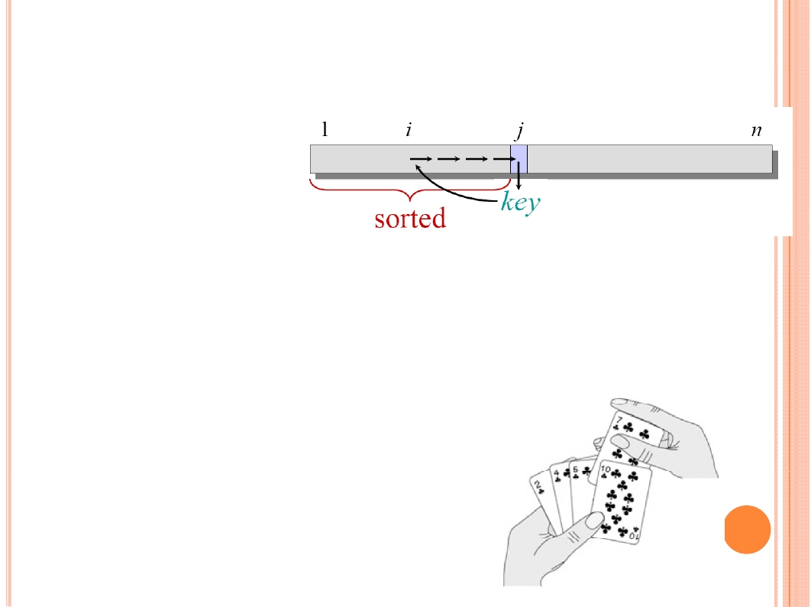
INSERTION SORT
Pseudocode
InsertionSort (A, n)
for j ←2 to n
do
key ← A[ j]
//Insert A[ j] into the sorted sequence A[1 .. j - 1].
i ← j - 1
while i > 0 and A[ i] > key
do
A[ i + 1] ←A[ i ]
i ← i -1
A[i +1] ←key

Slide 7

INSERTION SORT
Example:
8
2
4
9
3
6

Slide 8

INSERTION SORT
Example:
8
2
4
9
3
6

Slide 9
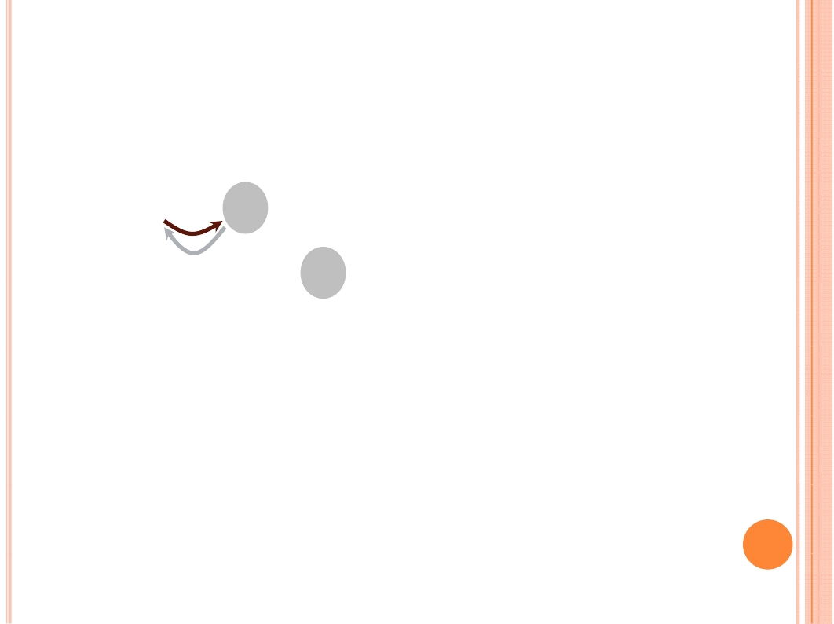
INSERTION SORT
Example:
8
2
2
8
4
4
9
9
3
3
6
6

Slide 10

INSERTION SORT
Example:
8
2
2
8
4
4
9
9
3
3
6
6

Slide 11
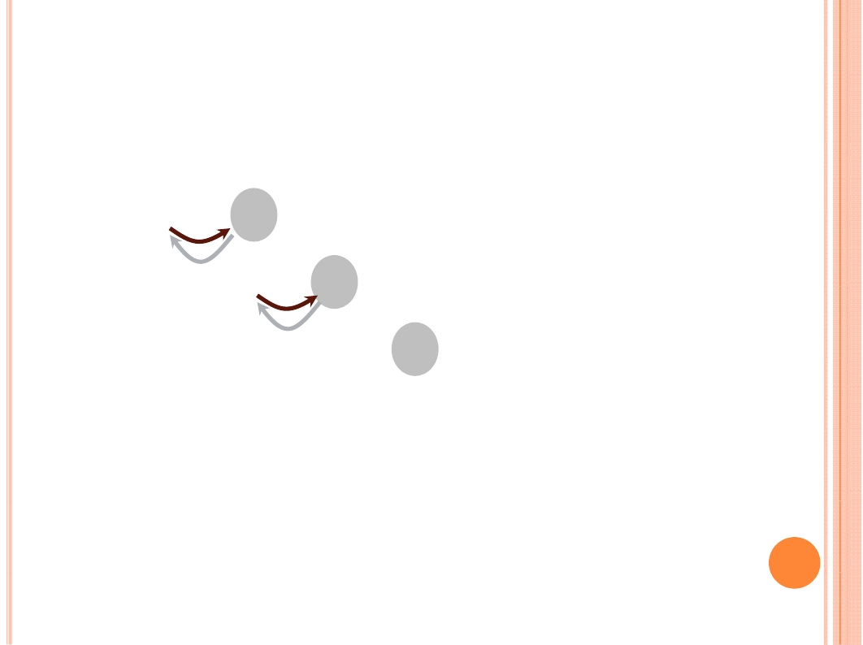
INSERTION SORT
Example:
8
2
2
2
8
4
4
4
8
9
9
9
3
3
3
6
6
6

Slide 12
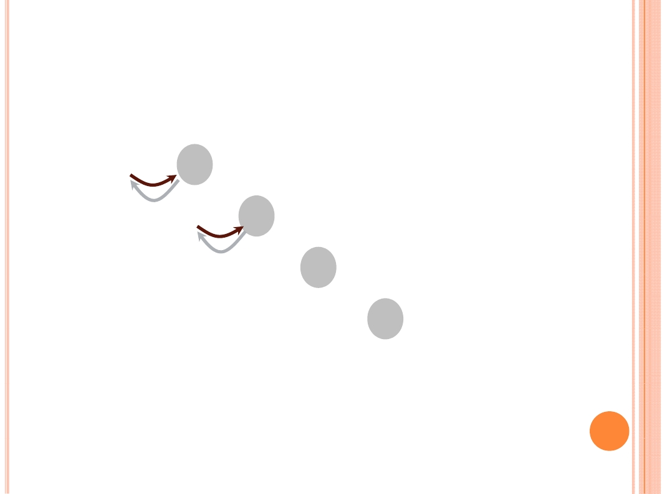
INSERTION SORT
Example:
8
2
2
2
2
8
4
4
4
4
8
8
9
9
9
9
3
3
3
3
6
6
6
6

Slide 13
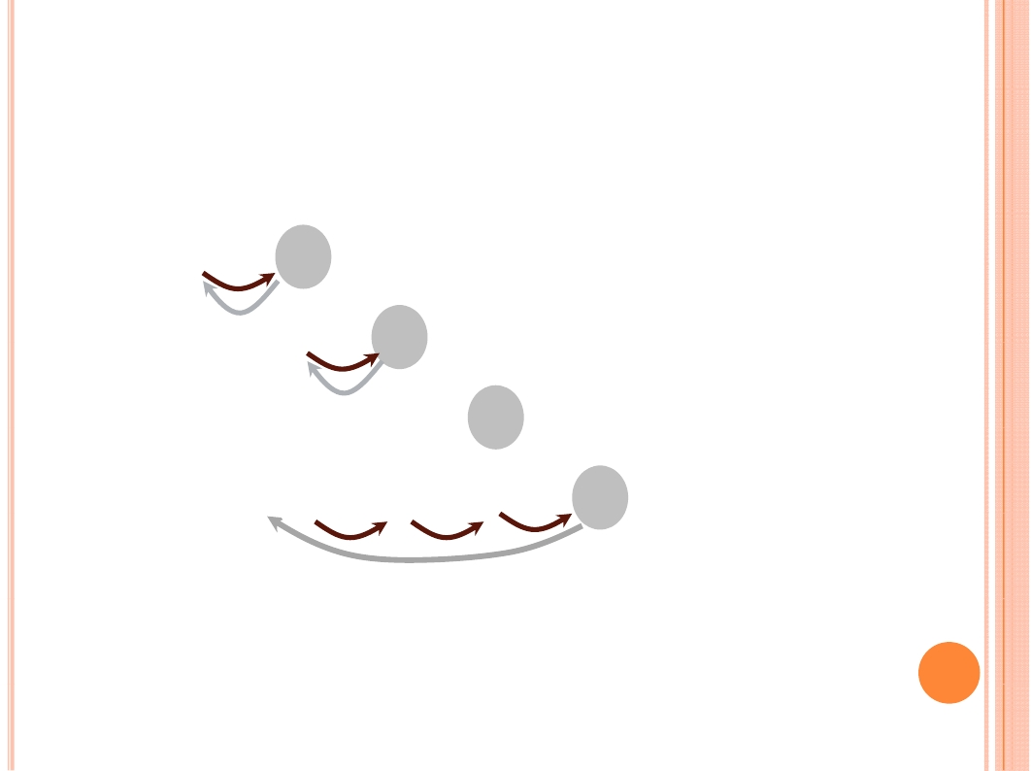
INSERTION SORT
Example:
8
2
2
2
2
8
4
4
4
4
8
8
9
9
9
9
3
3
3
3
6
6
6
6

Slide 14
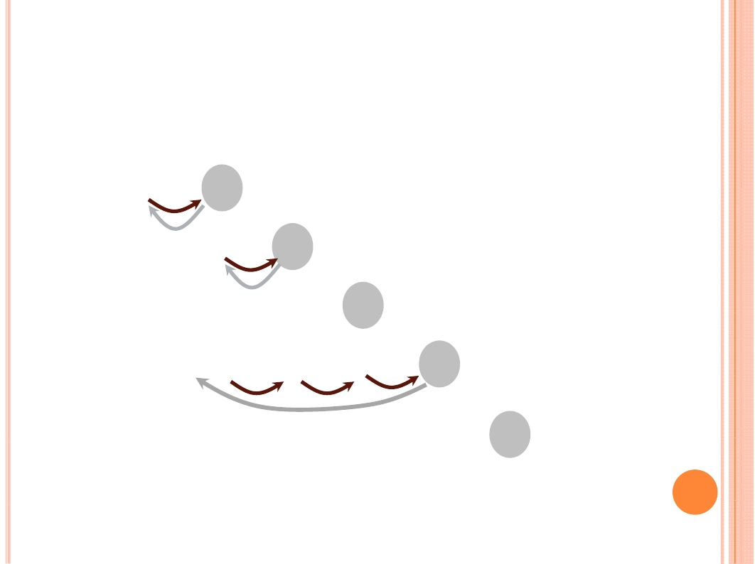
INSERTION SORT
Example:
8
2
2
2
2
2
8
4
4
3
4
4
8
8
4
9
9
9
9
8
3
3
3
3
9
6
6
6
6
6

Slide 15
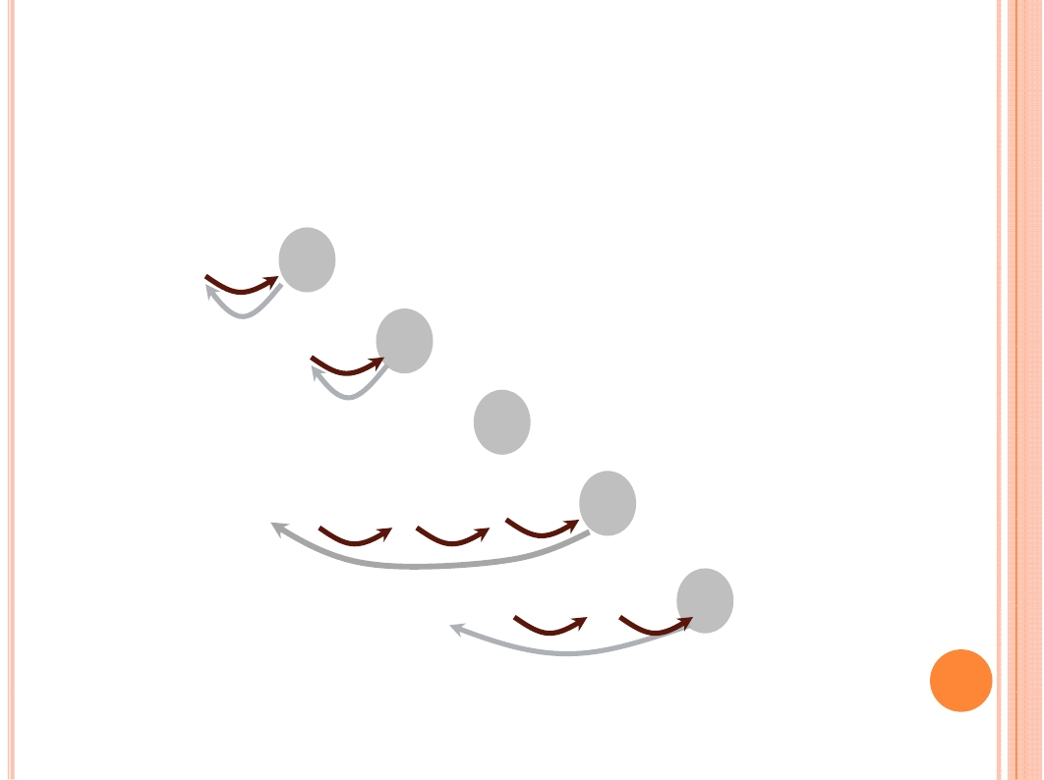
INSERTION SORT
Example:
8
2
2
2
2
2
2
8
4
4
3
3
4
4
8
8
4
4
9
9
9
9
8
6
3
3
3
3
9
8
6
6
6
6
6
9

Slide 16

INSERTION SORT
Example:
8
2
2
2
2
2
2
8
4
4
3
3
4
4
8
8
4
4
9
9
9
9
8
6
3
3
3
3
9
8
6
6
6
6
6
9

Slide 17

CORRECTNESS OF A ALGORITHM
For such an incremental algorithm, we can use loop
invariants to prove the correctness of the algorithm.
Loop invariants:
Initialization
It is true at the first loop
Maintenance
It is true before an iteration of loop, then true before next
iteration
Termination
The invariant guarantee the correctness at last iteration.

Slide 18

INSERTION SORT
Pseudocode
InsertionSort (A, n)
for j ←2 to n
do
key ← A[ j]
//Insert A[ j] into the sorted sequence A[1 .. j - 1].
i ← j- 1
while i > 0 and A[ i] > key
do
A[ i + 1] ←A[ i ]
i ← i -1
A[i +1] ←key

Slide 19

RUNNING TIME
The running time depends on the input
An already sorted sequence is easier to sort.
Parameterize the running time by the size of the
input---n, since short sequences are easier to be
sorted than the longer ones.
Generally, we seek upper bounds on the running
time, because everybody likes a guarantee---
worst case.

Slide 20

KINDS OF ANALYSES
Worst-case: (usually)
T(n) = maximum time of algorithm on any input of
size n.
Average-case: (sometimes)
T(n) = expected time of algorithm over all inputs of
size n.
Need assumption of statistical distribution of inputs.
Best-case: (bogus)
Cheat with a slow algorithm that works fast on some
input.

Slide 21
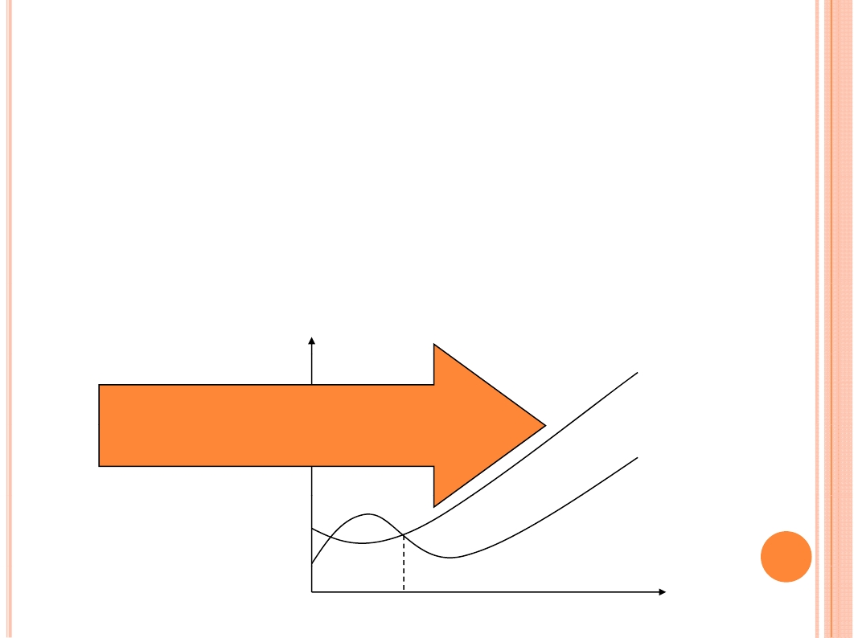
ASYMPTOTIC TIME ANALYSIS
Big O time complexity
T (n) = O (f (n)) if there exist positive constant c
and n₀ such that T (n) <= cf (n) when n ≥ n₀.
A kind of asymptotic upper bound
c*f (n)
c*f (n) is an upper bound for T (n)
n0
T (n)
n

Slide 22
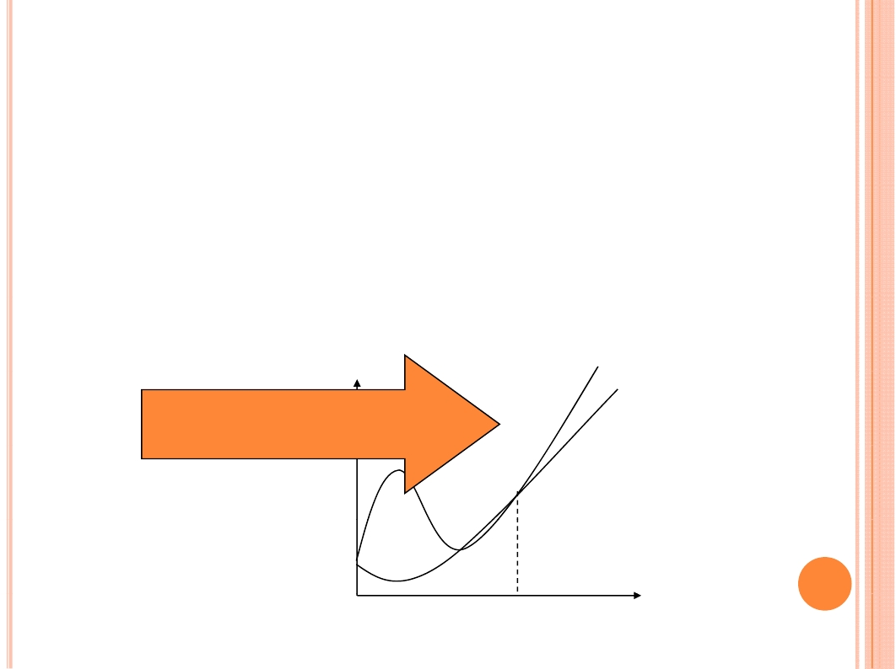
ASYMPTOTIC TIME ANALYSIS
Big Ω time complexity
T (n) = Ω (g(n)) if there exist positive constant c
and n₀ such that T (n) ≥ cg (n) when n ≥ n₀.
A kind of asymptotic lower bound
c*g(n) is an lower bound for T(n)
c*g(n)
T(n)
n
n0

Slide 23

ASYMPTOTIC TIME ANALYSIS
T (n) = Θ( f (n) ) if and only if T (n) = O ( f (n) ) and T (n) = Ω (
f (n) )
T (n) = o ( f (n) ) if T (n) = O ( f (n) ) and T (n) ≠ Θ ( f (n) )
We can determine the relative growth rates of f (n) and g (n) by
computing lim n->infinite f (n) / g (n)
0: f (n) = o (g (n)))
a constant c: f (n) = Θ ( g (n) )
infinite: g (n) = o ( f (n))
If T1(n) = Θ ( f (n) ) and T2(n) = Θ ( g (n) )
T₁(n) + T₂(n) = max (Θ ( f (n) ), Θ ( g (n) ) )
T₁(n) * T₂(n) = Θ ( f (n) ) * Θ ( g (n) )

Slide 24
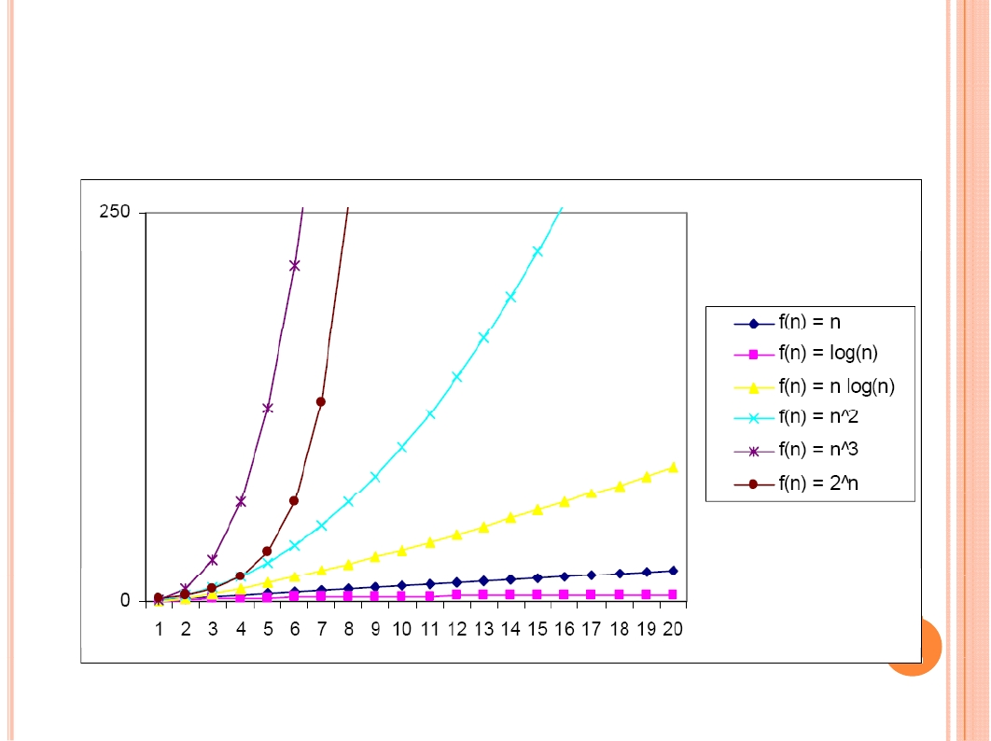
PRACTICAL EXAMPLE

Slide 25
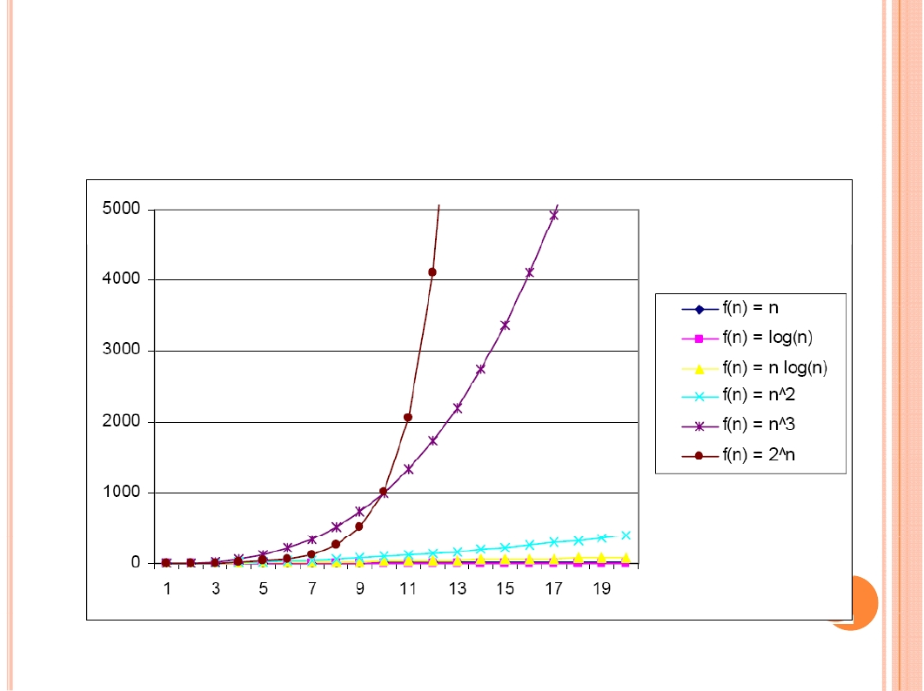
PRACTICAL EXAMPLE

Slide 26
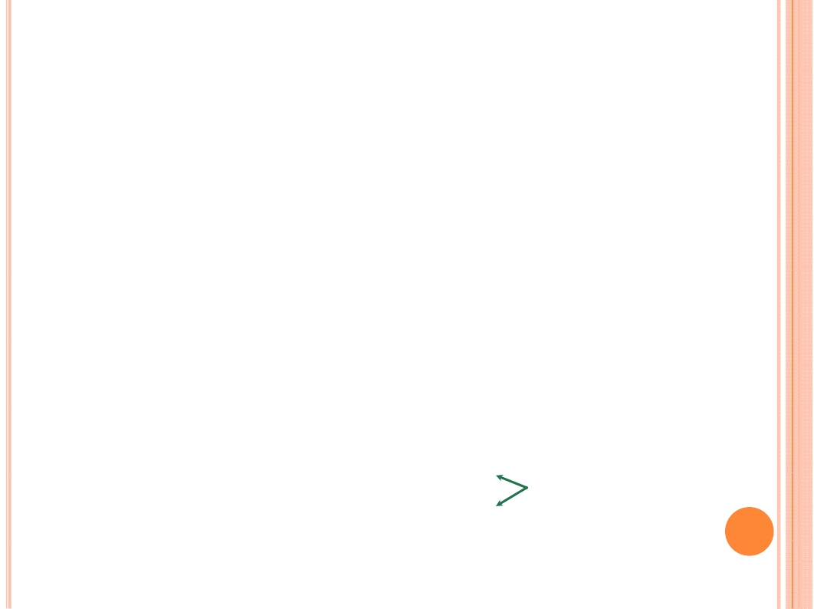
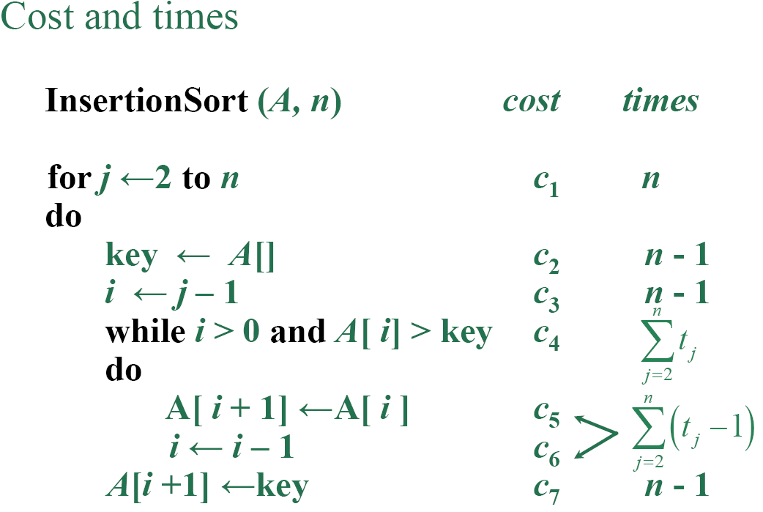
INSERTION SORT ANALYSIS
Cost and times

Slide 27
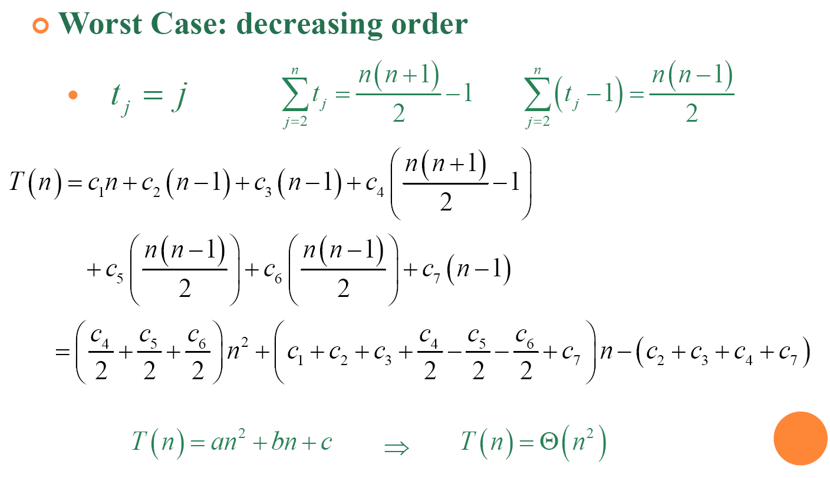
INSERTION SORT ANALYSIS
Worst Case: decreasing order

Slide 28
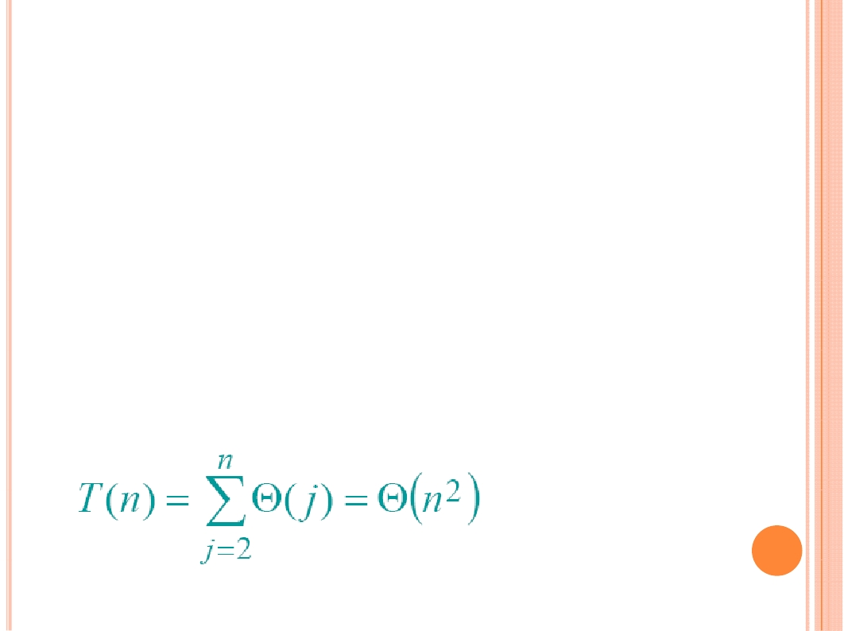
INSERTION SORT ANALYSIS
Worst Case: decreasing order
InsertionSort (A, n)
for j ← 2 to n
do
Insert A[ j ] into the sorted sequence A[1 .. j - 1].

Slide 29

RECURRENCE &
DIVIDE-AND-CONQUER

Slide 30
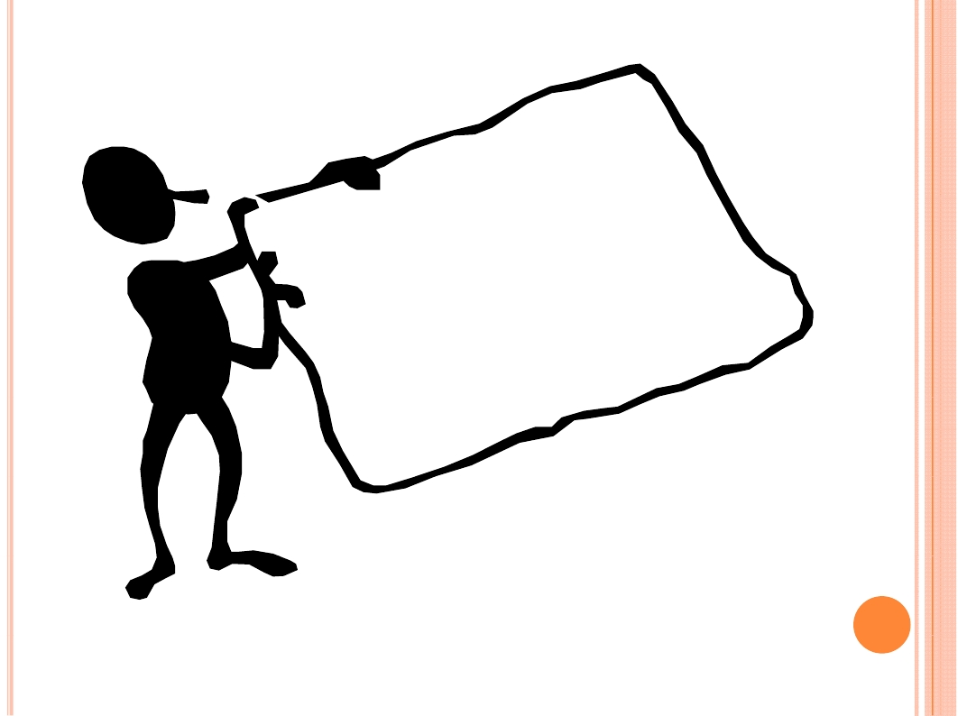
How to solve
a large scale
problem?

Slide 31
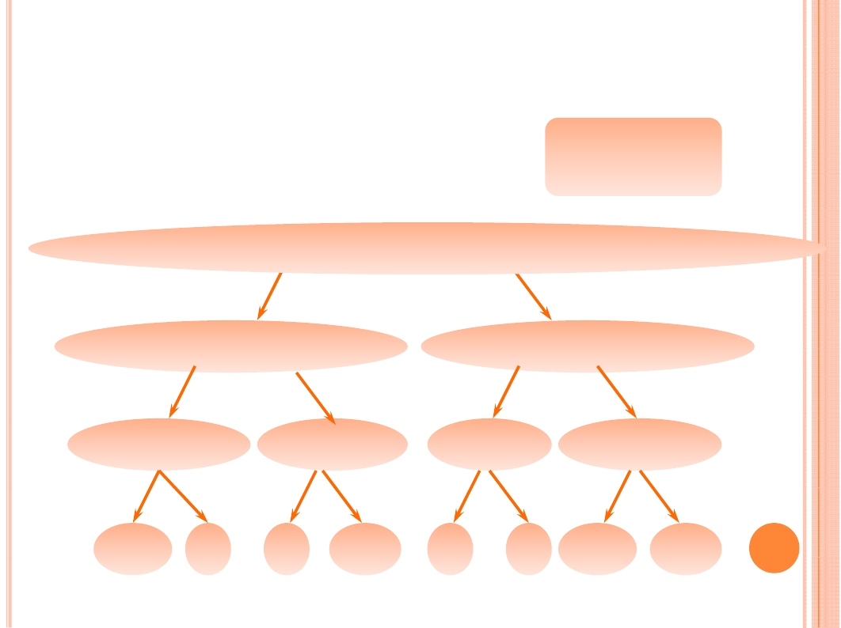
MERGE SORT
Example:
Input: 13, 2, 7, 20, 1, 9, 11, 12
Divide
13
2
7
20
1
9
11
12
13
2
7 20
1 9
11
12
13 2
7
20
1
9
11
12
13
2
7
20
1
9
11
12

Slide 32

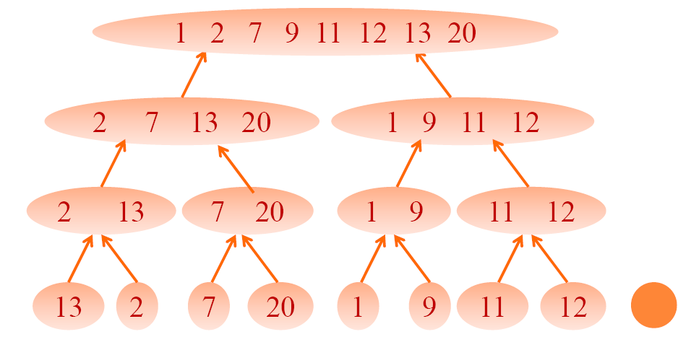
MERGE SORT
Example:
Input: 13, 2, 7, 20, 1, 9, 11, 12
Merge

Slide 33
MERGE SORT
Merge Sort
MergeSort( A, p, r )
if p < r
then
q <-
MergeSort (A, p, q )
MergeSort (A, q + 1, r )
Merge (A, p, q, r )

Slide 34

DIVIDE-AND-CONQUER
Recursive problems
Call themselves recursively one or more times to deal
with closely related subproblems.
Divide and Conquer
Break the problem into several subproblems
Subproblems are similar to the original problem but smaller in size
Conquer the subproblems by solving subproblems
recursively
Then combine these solutions to create a solution to
the original problem.

Slide 35
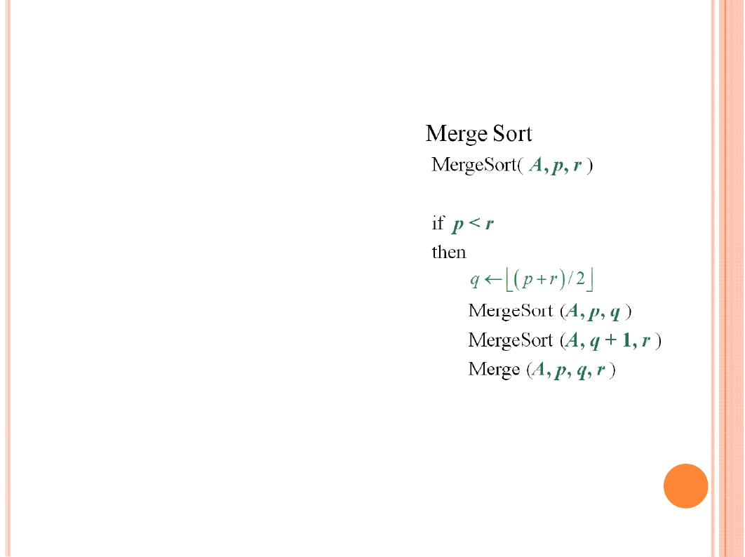
MERGE SORT
Divide
Trivial.
Conquer
Recursively sort 2 subarrays.
2T ( n / 2 )
Combine

Slide 36

MERGE IN LINEAR TIME
20 12
13 11
7 9
2
1

Slide 37

MERGE IN LINEAR TIME
20 12
13 11
7 9
2
1

Slide 38

MERGE IN LINEAR TIME
20 12
13 11
20 12
13 11
7 9
7
9
2
1
2

Slide 39
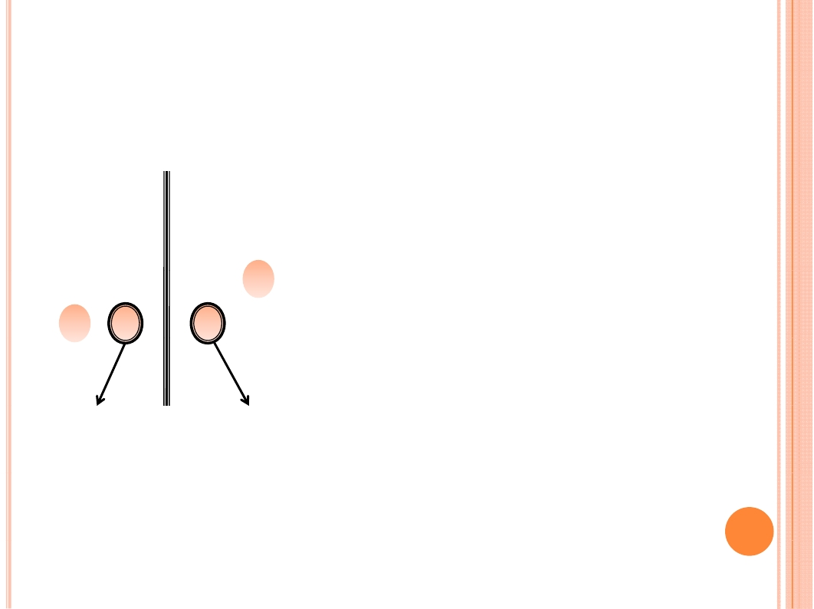
MERGE IN LINEAR TIME
20 12
13 11
20 12
13 11
7 9
7
9
2
1
2

Slide 40
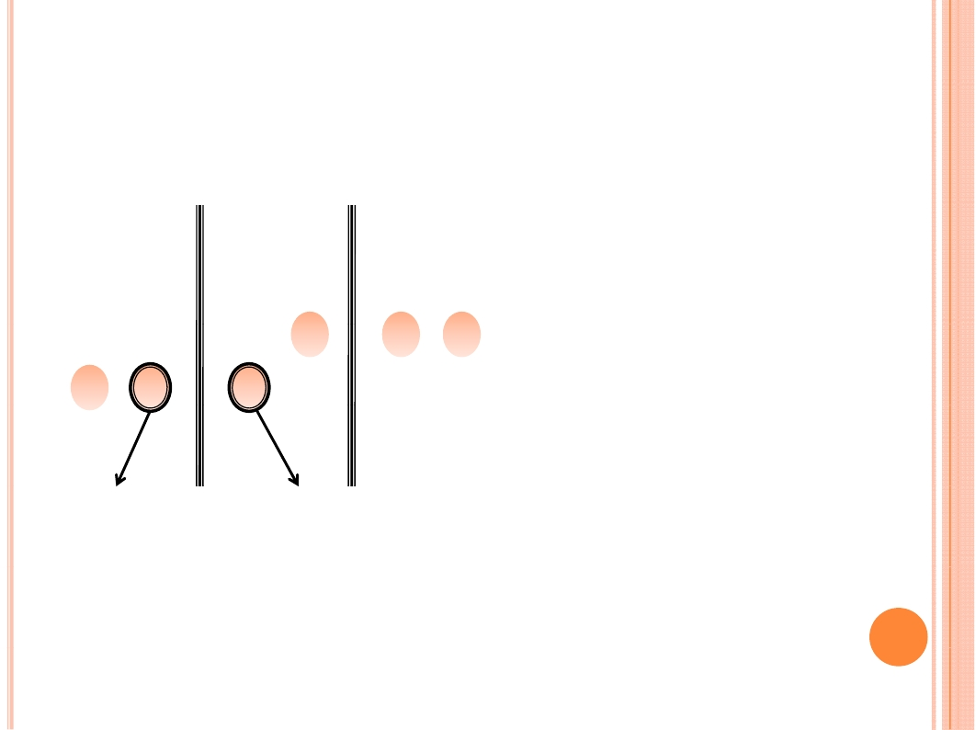
MERGE IN LINEAR TIME
20 12
13 11
20 12
13 11
20 12
13 11
7 9
7
2
9
7
9
2
1

Slide 41
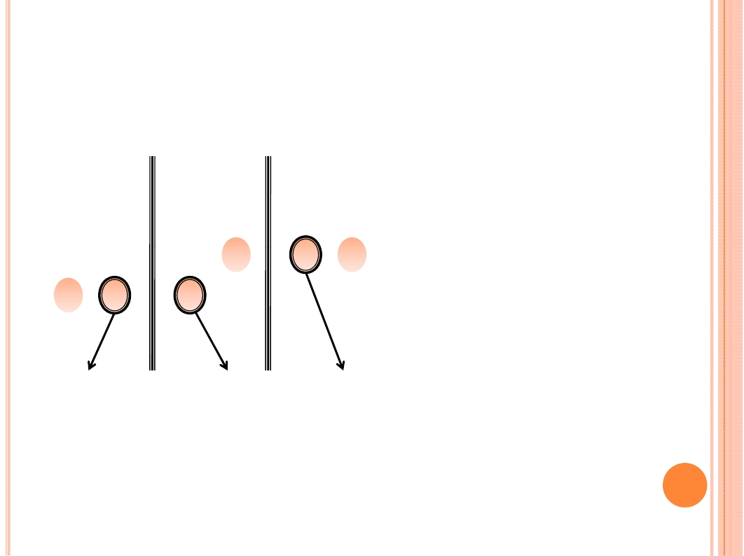
MERGE IN LINEAR TIME
20 12
13 11
20 12
13 11
20 12
13 11
7 9
7
2
9
7
9
2
1

Slide 42
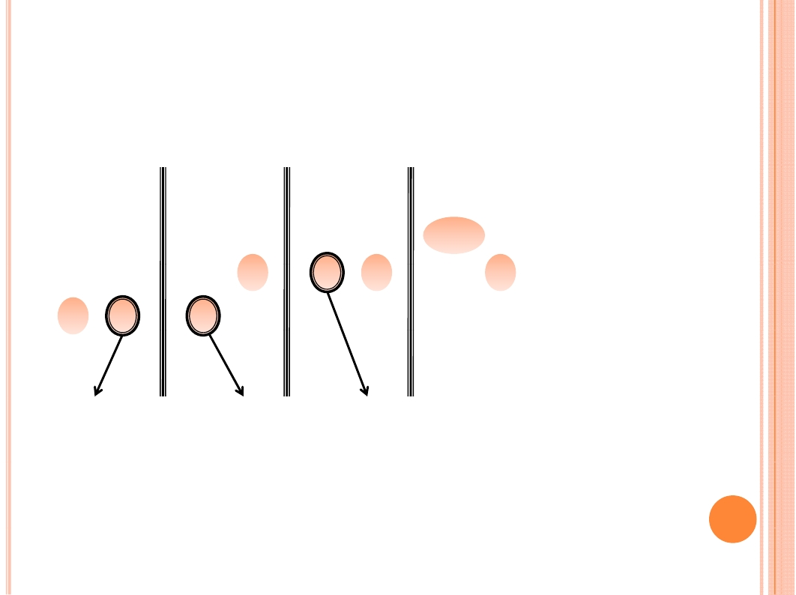
MERGE IN LINEAR TIME
20 12
13 11
20 12
13 11
20 12
13 11
20 12
13 11
7 9
7
9
7
9
9
2
1
2

Slide 43
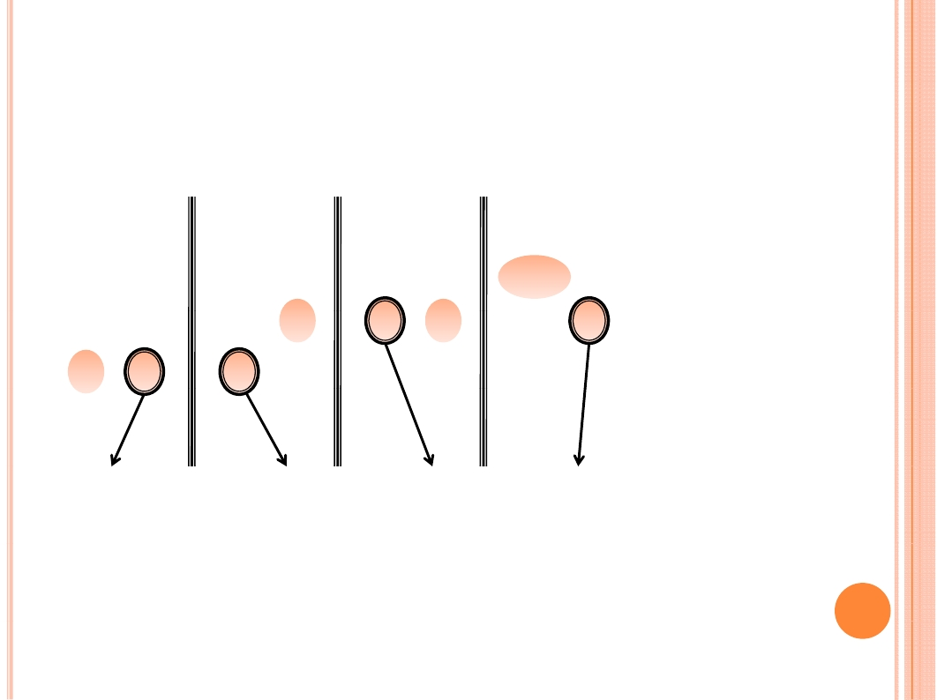
MERGE IN LINEAR TIME
20 12
13 11
20 12
13 11
20 12
13 11
20 12
13 11
7 9
7
9
7
9
9
2
1
2

Slide 44
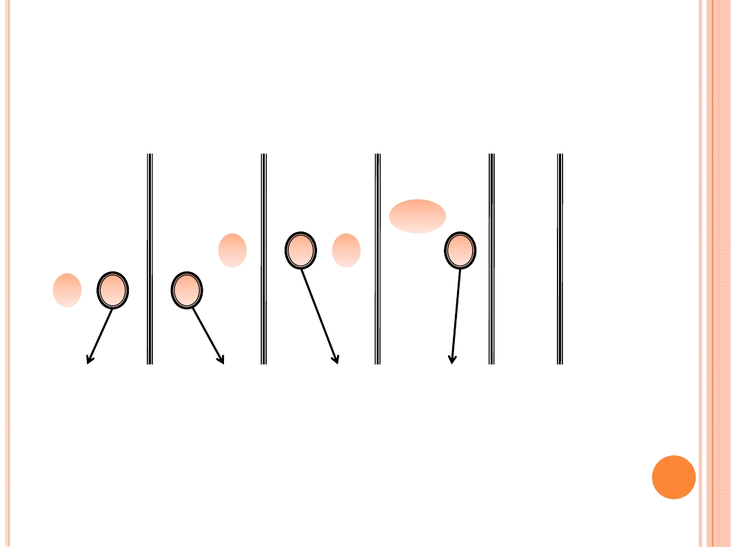
MERGE IN LINEAR TIME
20 12
20 12
20 12
20 12
13 11
13 11
13 11
13 11
…
7 9
7
9
7
9
9
2
1
2

Slide 45
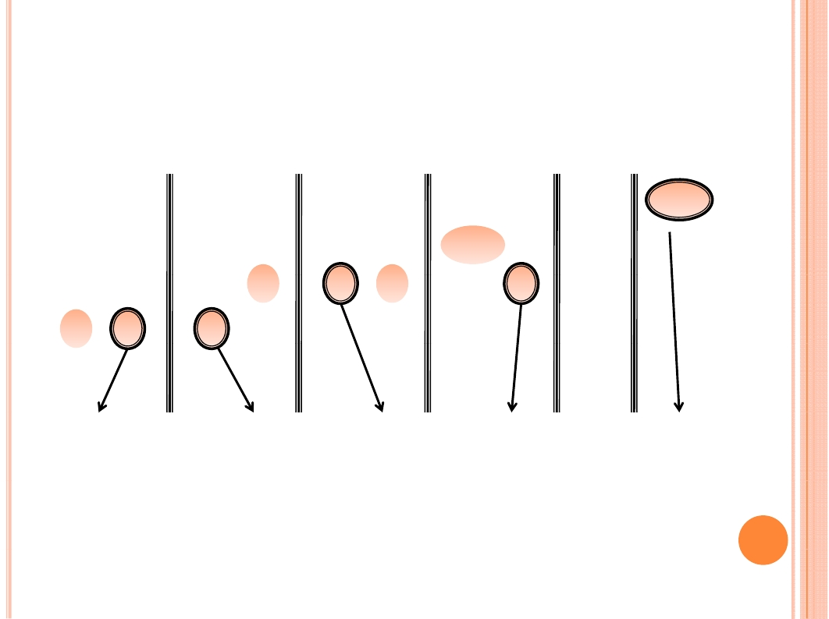
MERGE IN LINEAR TIME
20 12
13 11
20 12
13 11
20 12
13 11
20 12
13 11
20
…
7 9
7
9
7
9
9
2
1
2

Slide 46

MERGE SORT
Divide
Trivial.
Conquer
Recursively sort 2 subarrays.
2T ( n / 2 )
Combine
Merge in linear time

Slide 47
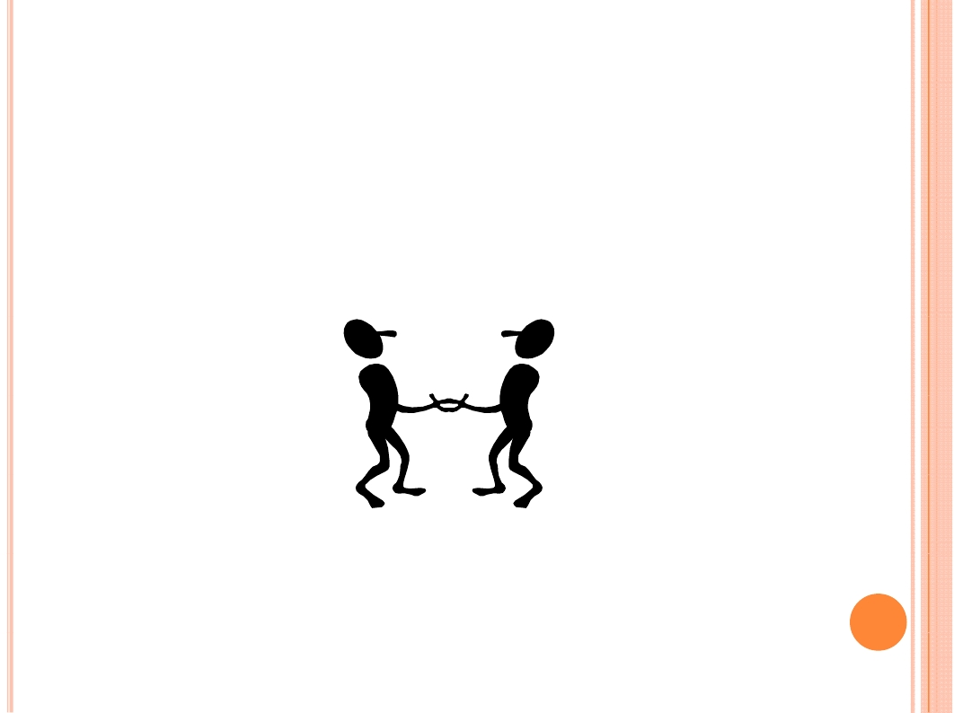
RECURRENCES AND DIVIDE-AND-CONQUER
Recurrence:
A recurrence is an equation or inequality that describes
a function in terms of its value on smaller inputs.
Recurrence and Divide and Conquer
Twins
???How to resolve a Recurrence?

Slide 48
RECURRENCES
Three methods:
Substitution method
Recursion tree method
Master method

Slide 49

SUBSTITUTION METHOD
The most general method:
1. Guess the form of the solution.
2. Verify by induction.
3. Solve for constants.
Example: T(n) = 4T( n / 2) + n
• [Assume that T(1) = Θ(1).]
• Guess O(n³) . (Prove O and Ω separately.)
• Assume that T(k) ≤ ck³ for k < n .
• Prove T(n) ≤ cn³ by induction.

Slide 50

Example of substitution
• We must also handle the initial conditions,
that is, ground the induction with base cases.
• Base: T(n) = Θ(1) for all n < n₀, where n₀ is
a suitable constant.
• For 1 ≤ n < n₀, we have “Θ(1)” ≤ cn³, if we
pick c big enough.

Slide 51
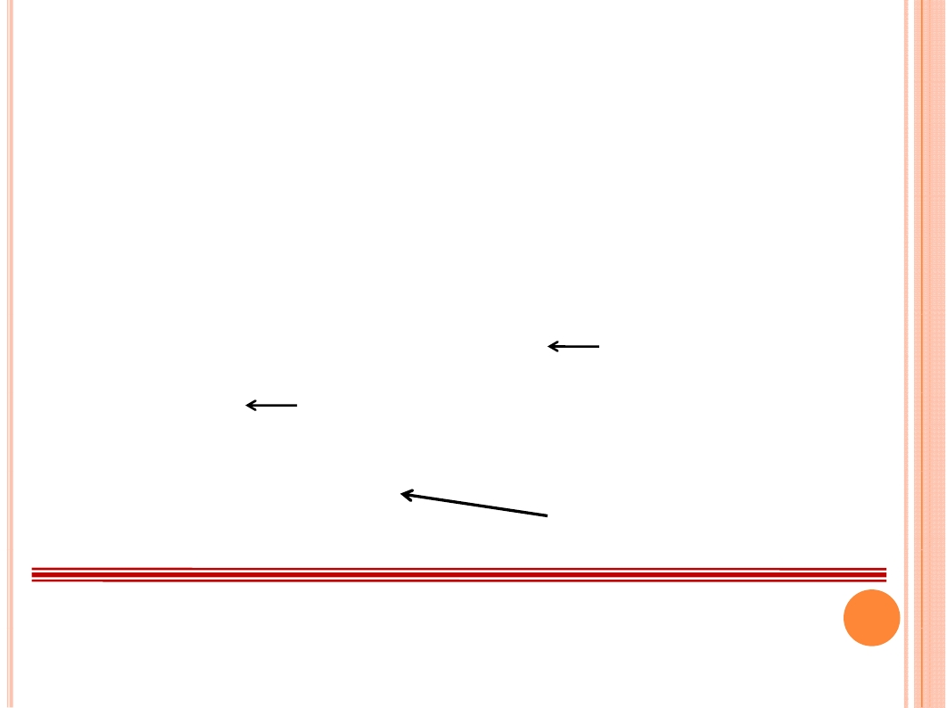
Example (continued)
T(n) = 4T(n / 2) + n
≤ 4c(n / 2)³ + n
= (c / 2)n³ + n
= cn³ – ((c / 2)n³ – n)
desired - residual
≤ cn³
desired
Whenever (c/2)n³ – n ≥ 0 , for example,
If c ≥ 2 and n ≥ 1.
residual
This bound is not tight!

Slide 52

A tighter upper bound?
We shall prove that T(n) = O(n²).
Assume that T(k) ≤ ck² for k < n:
T(n) = 4T(n / 2) + n
≤ cn² + n
= cn² – (– n)
≤ cn²
for no choice n when c > 0. Lose!

Slide 53

A tighter upper bound!
IDEA: Strengthen the inductive hypothesis.
• Subtract a low-order term.
Inductive hypothesis: T(k) ≤ c₁k² – c₂k for k < n.
T(n) = 4T(n / 2) + n
≤ 4(c₁ (n/2)² – c₂(n/2)) + n
= c₁n² – 2c₂n + n
= c₁n² – c₂n – (c₂n – n)
≤ c₁n² – c₂n if c₂ >1.
Pick c₁ big enough to handle the initial conditions.

Slide 54

Recursion-tree method
• A recursion tree models the costs (time) of a
recursive execution of an algorithm.
• The recursion tree method is good for
generating guesses for the substitution method.

Slide 55

Example of recursion tree
Solve T(n) = T(n/4) + T(n/2) + n²:

Slide 56

Example of recursion tree
Solve T(n) = T(n/4) + T(n/2) + n² :
T(n)

Slide 57
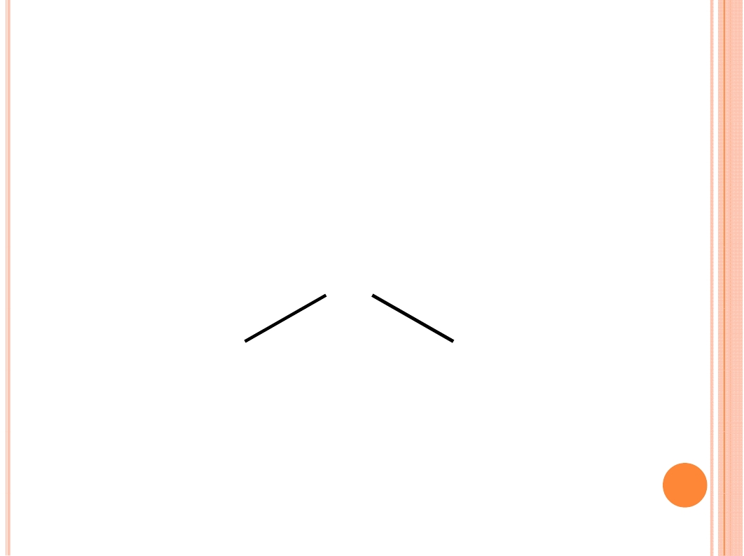
Example of recursion tree
Solve T(n) = T(n/4) + T(n/2) + n² :
n²
T(n/4)
T(n/2)

Slide 58
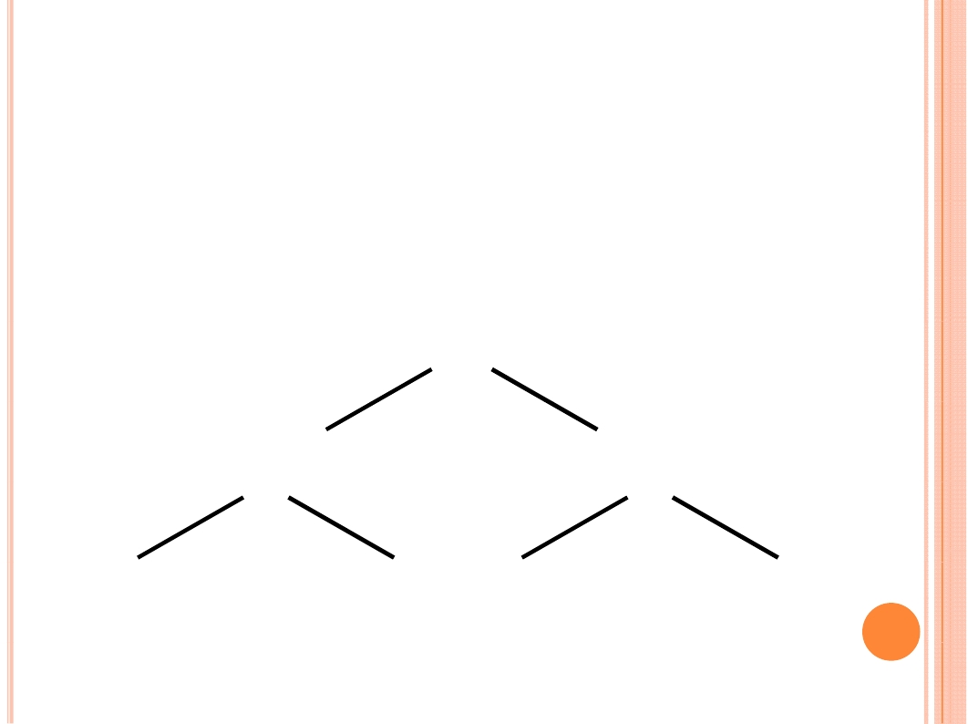
Example of recursion tree
Solve T(n) = T(n/4) + T(n/2) + n² :
n²
(n/4)²
(n/2)²
T(n/16)
T(n/8)
T(n/8)
T(n/4)

Slide 59
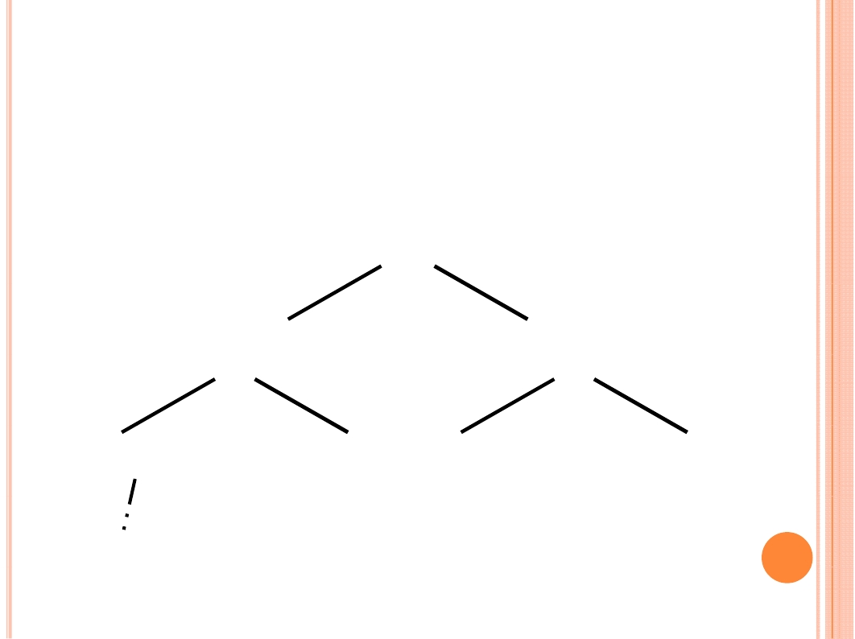
Example of recursion tree
Solve T(n) = T(n/4) + T(n/2) + n² :
n²
(n/4)²
(n/2)²
T(n/16)
T(n/8)
T(n/8)
T(n/4)
Θ(1)

Slide 60
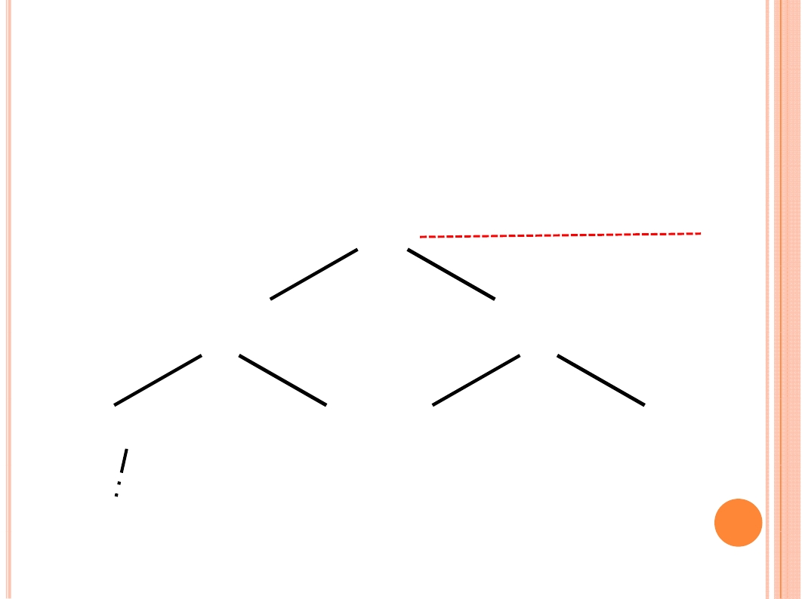
Example of recursion tree
Solve T(n) = T(n/4) + T(n/2) + n² :
n²
n²
(n/4)²
(n/2)²
(n/16)²
(n/8)²
(n/8)²
(n/4)²
Θ(1)

Slide 61
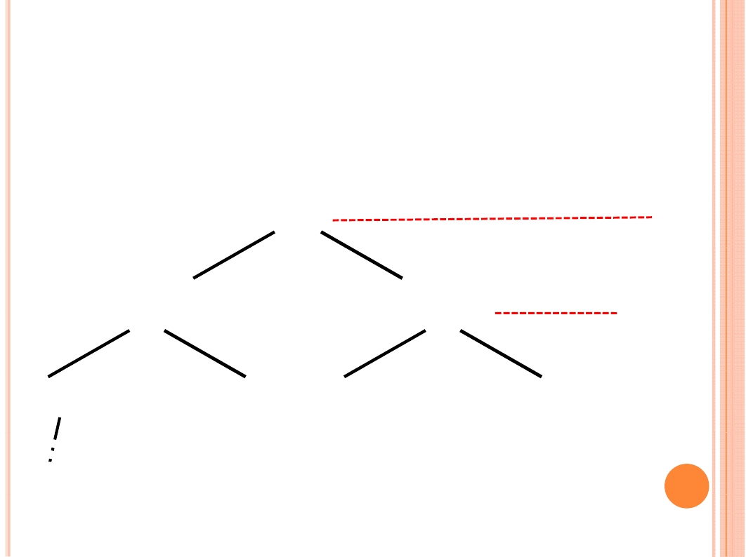
Example of recursion tree
Solve T(n) = T(n/4) + T(n/2) + n²:
n²
n²
(n/4)²
(n/2)²
5n²/16
(n/16)²
(n/8)²
(n/8)²
(n/4)²
Θ(1)

Slide 62
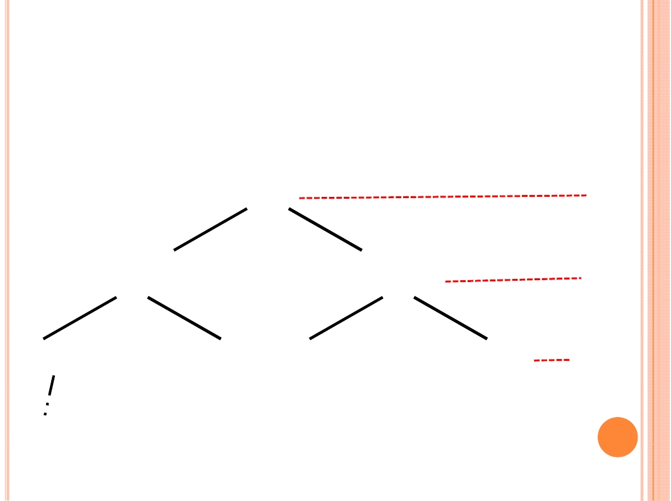
Example of recursion tree
Solve T(n) = T(n/4) + T(n/2) + n²:
n²
n²
(n/4)²
(n/2)²
5n²/16
(n/16)²
(n/8)²
(n/8)²
(n/4)²
25n²/256
…
…...
Θ(1)

Slide 63
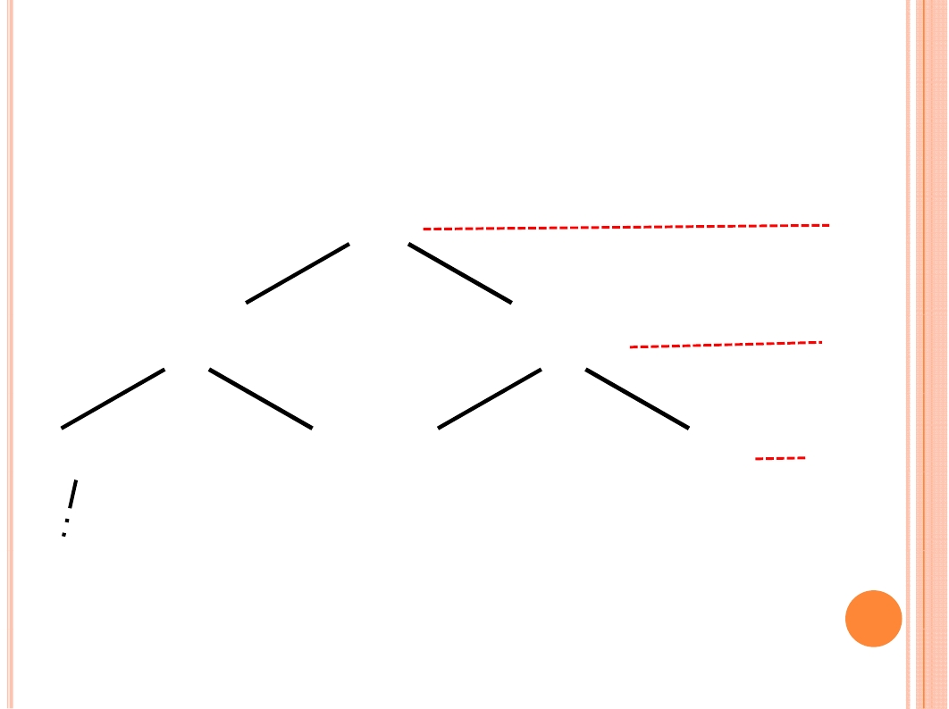
Example of recursion tree
Solve T(n) = T(n/4) + T(n/2) + n² :
n²
n²
(n/4)²
(n/2)²
5n²/16
(n/16)²
(n/8)²
(n/8)²
(n/4)²
25n²/256
…
Θ(1)
Total = n² ( 1 + 5/16 + (5/16)2 + (5/16)3 + …)
= Θ(n²)
geometric series

Slide 64

The master method
The master method applies to recurrences of
the form
T(n) = a T(n/b) + f (n) ,
where a ≥ 1, b > 1

Slide 65

Three common cases
Compare f (n) with n^{log}bª:
1.f (n) = O(n^{log}b^{a - ε}) for some constant ε > 0.
• f (n) grows polynomially slower than n^{log}bª
(by an n^{ε} factor).
Solution: T(n) = Θ(n^{log}bª) .
2.f (n) = Θ(n^{log}bª lg^{k}n) for some constant k ≥ 0.
• f (n) and n^{log}bª lg^{k}n grow at similar rates.
Solution:T(n) = Θ(n^{log}bª lg^{k+1}n) .

Slide 66

Three common cases
Compare f (n) with n^{log}bª:
3.f (n) = Ω(n^{log}b^{a - ε}) for some constant ε > 0.
• f (n) grows polynomially faster than n^{log}bª (by
an n^{ε} factor),
and f (n) satisfies the regularity condition that
a f(n/b) ≤ c f(n) for some constant c < 1.
Solution: T(n) = Θ( f (n)) .

Slide 67
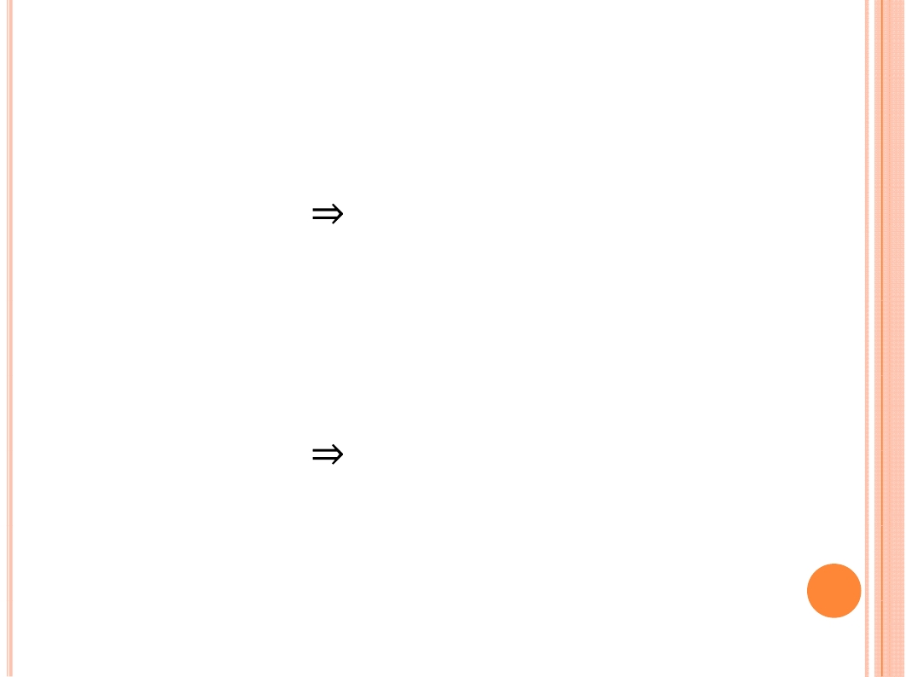
Examples
Ex. T(n) = 4T(n/2) + n
a = 4, b = 2
n^{log}bª = n² ; f (n) = n.
CASE 1: f (n) = O(n^{2 - ε}) for ε = 1.
∴ T(n) = Θ(n²).
Ex. T(n) = 4T(n/2) + n²
a = 4, b = 2
n^{log}bª = n²; f (n) = n².
CASE 2: f (n) = Θ(n²lg⁰n), that is, k = 0.
∴T(n) = Θ(n²lg n).

Slide 68
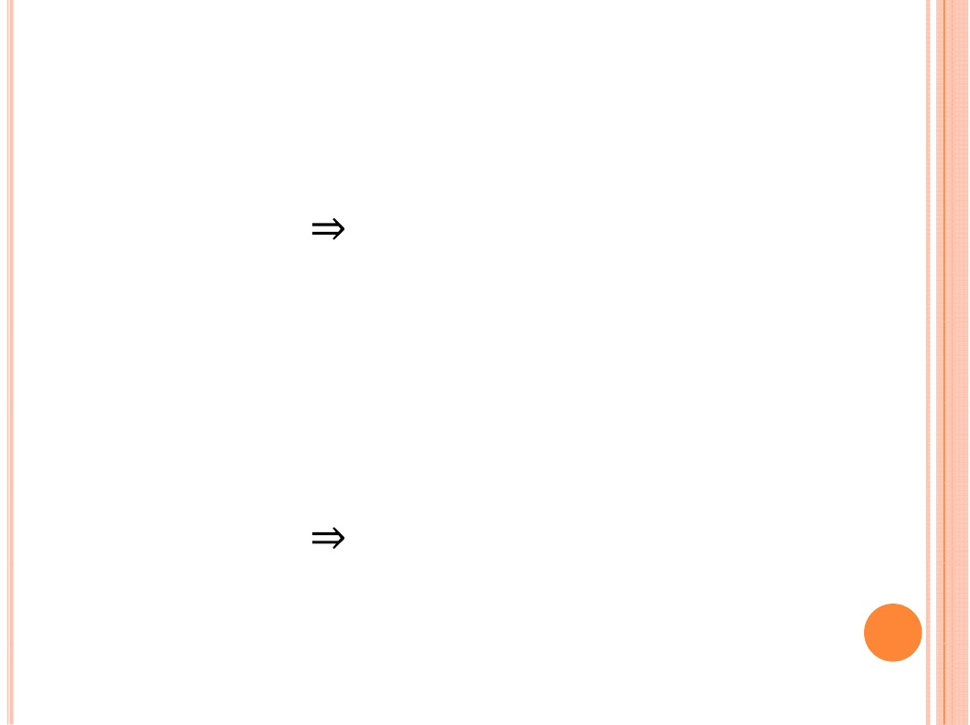
Examples
Ex. T(n) = 4T(n/2) + n³
a = 4, b = 2
n^{log}bª = n²; f (n) = n³.
CASE 3: f (n) = Ω(n^{2 - ε}) for ε = 1
and 4(cn/2)³ ≤ cn³ (reg. cond.) for c = 1/2.
∴ T(n) = Θ(n³).
Ex. T(n) = 4T(n/2) + n²/lgn
a = 4, b = 2
n^{log}bª = n²; f (n) = n² /lgn.
Master method does not apply.

Slide 69
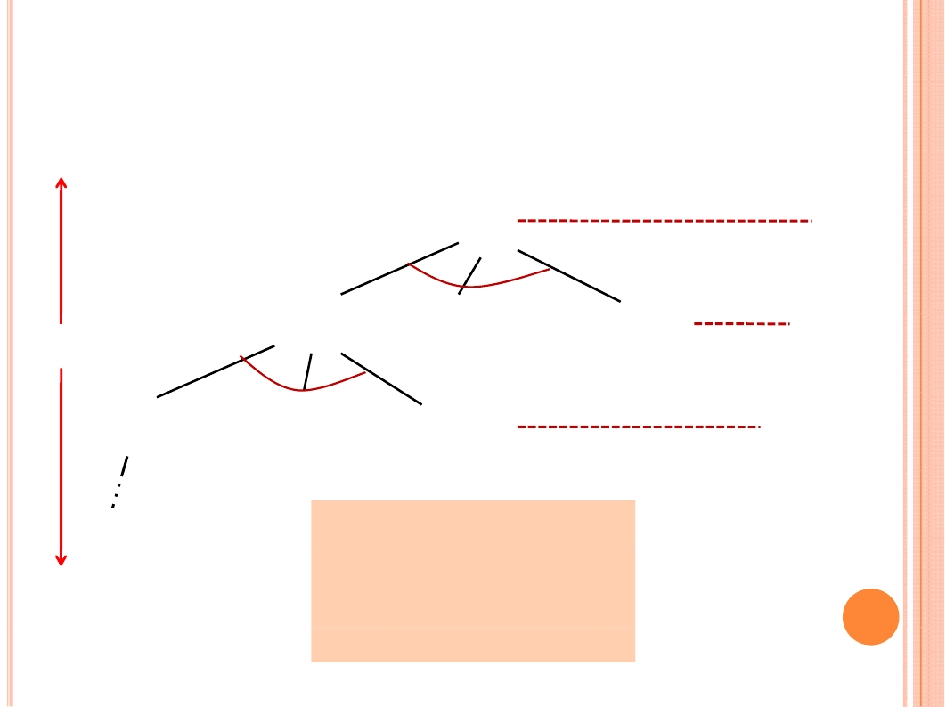
Idea of master theorem
Recursion tree:
f(n)
f(n)
a
f(n/b) f(n/b) … f(n/b)
a
af(n/b)
h=log_{b}n
f(n/b²) f(n/b²) … f(n/b²)
a²f(n/b²)
…
T(1)
#leaves = a^{h}
= a^{log}b^{n}
= n^{log}bª
n^{log}bªT(1)

Slide 70
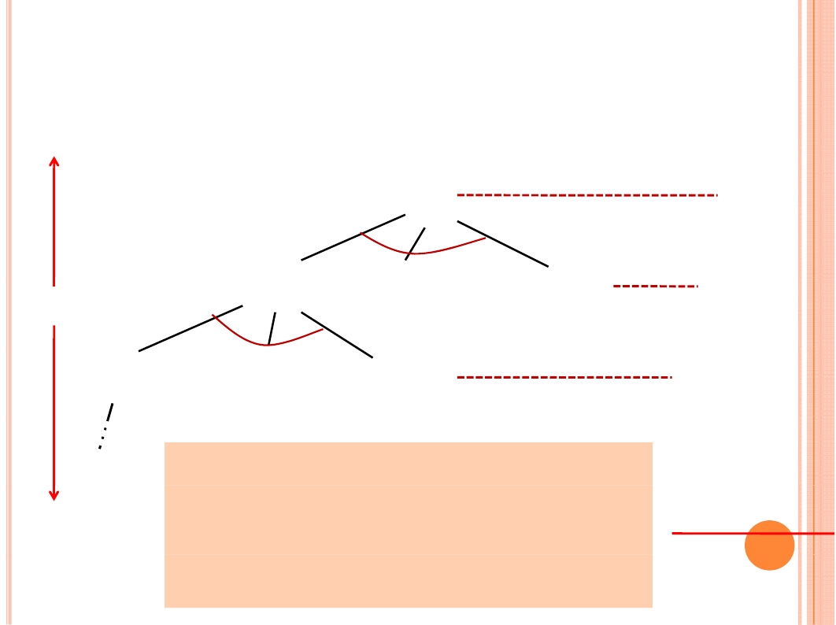
Idea of master theorem
Recursion tree:
f(n)
f(n)
a
f(n/b) f(n/b) … f(n/b)
a
af(n/b)
h=log_{b}n
f(n/b²) f(n/b²) … f(n/b²)
T(1) CASE 1: The weight increases
geometrically from the root to the
leaves. The leaves hold a constant
fraction of the total weight
a²f(n/b²)
n^{log}bªT(1)
Θ(n^{log}bª)
…
…

Slide 71
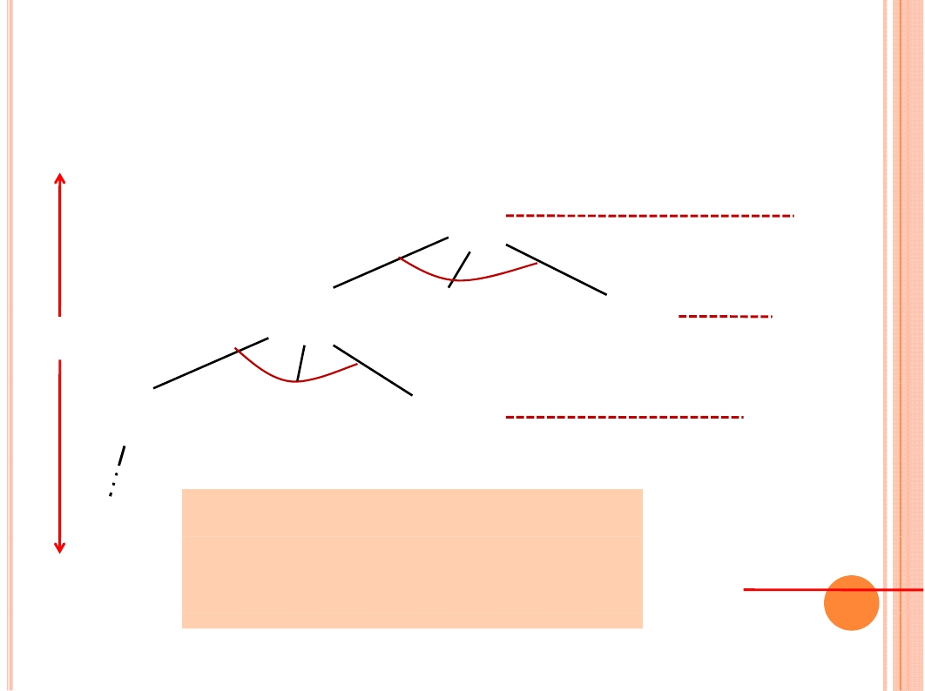
Idea of master theorem
Recursion tree:
f(n)
f(n)
a
f(n/b) f(n/b) … f(n/b)
a
af(n/b)
h=log_{b}n
f(n/b²) f(n/b²) … f(n/b²)
T(1) CASE 2: (k = 0) The weight
is approximately the same on
each of the log_{b}n levels
a²f(n/b²)
n^{log}bªT(1)
Θ(n^{log}bªlgn)
…
…

Slide 72
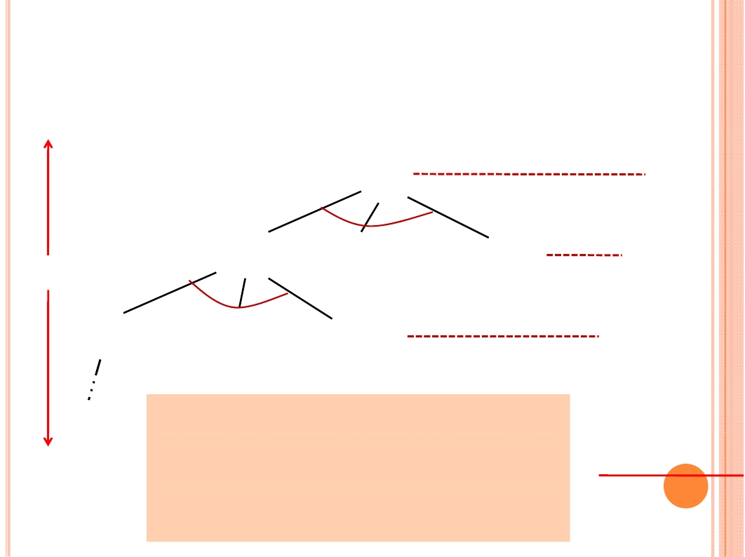
Idea of master theorem
Recursion tree:
f(n)
f(n)
a
f(n/b) f(n/b) … f(n/b)
a
af(n/b)
h=log_{b}n
f(n/b²) f(n/b²) … f(n/b²)
T(1) CASE 3: The weight decreases
geometrically from the root to the
leaves. The root holds a constant
fraction of the total weight.
a²f(n/b2)
n^{log}bªT(1)
Θ(f(n))
…
…

Slide 73

BIG INTEGER
MULTIPLICATION

Slide 74

BIG INTEGER MULTIPLICATION
Input: two n-bit integer X and Y
Output: the product of X and Y
Traditional method： O(n²)
Divide-and-conquer:
low efficiency
X=
Y=
X = a 2^{n/2} + b
a
c
b
d
Y = c 2^{n/2} + d
XY = ac 2^{n} + (ad + bc) 2^{n/2} + bd

Slide 75
BIG INTEGER MULTIPLICATION
Input: two n-bit integer X and Y
Output: the product of X and Y
Traditional method： O(n²)
Divide-and-conquer:
low efficiency
X=
Y=
X = a 2n/2 + b
a
c
b
d
no improvement
Y = c 2n/2 + d
XY = ac 2^{n} + (ad + bc) 2^{n/2} + bd

Slide 76

BIG INTEGER MULTIPLICATION
XY = ac 2^{n} + (ad + bc) 2^{n/2} + bd
Reduce the times of multiplication
1. XY = ac 2^{n} + ((a - c)(b - d) + ac + bd ) 2^{n/2} + bd
2. XY = ac 2^{n} + ((a + c)(b + d) - ac - bd) 2^{n/2} + bd
Notice: we do not use euqation 2, for summation
may conduct n+1 bits number.

Slide 77
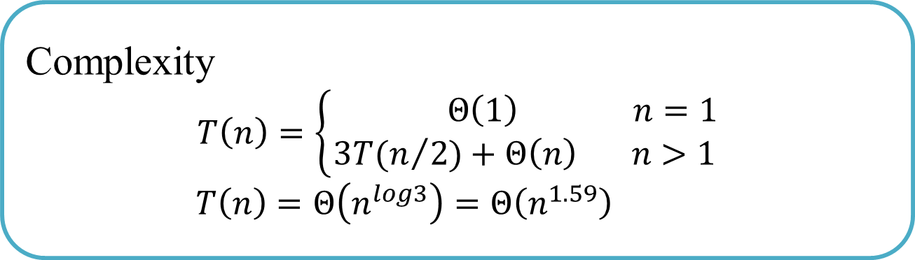
BIG INTEGER MULTIPLICATION
XY = ac 2^{n} + (ad + bc) 2^{n/2} + bd
Reduce the times of multiplication
1. XY = ac 2^{n} + ((a - b)(d - c) + ac + bd ) 2^{n/2} + bd
2. XY = ac 2^{n} + ((a + b)(c + d) - ac - bd) 2^{n/2} + bd
Complexity
$$T\left(n\right)=\left\{\begin{aligned} Θ\left(1\right) n=1 \\ 3T(n/{2)+Θ\left(n\right) n>1}\end{aligned}\right.$$
$$T\left(n\right)=Θ\left(n^{log3}\right)=Θ\left(n^{1.59}\right)$$
Notice: we do not use euqation 2, for summation
may conduct n+1 bits number.
improved

Slide 78

BIG INTEGER MULTIPLICATION
Even faster algorithm:
•Divide into more pieces, and use the complex methods to merge,
may leads to more optimal algorithm.
•This idea conduct Fast Fourier Transform(FFT)。 FFT can be
seen as a complex Divide-and-Conquer method. For Multiple it
solve in Θ(nlogn) 。

Slide 79

STRASSEN MATRIX
MULTIPLICATION

Slide 80

STRASSEN MATRIX MULTIPLICATION
C = AB where
Traditional algorithm: T(n)= Θ(n³)
Divide and Conquer: T(n)= Θ(n^{log7}) = Θ(n^{2.81})
Now the best performance is Θ(n^{2.376})

Slide 81

Chessboard
Cover

Slide 82
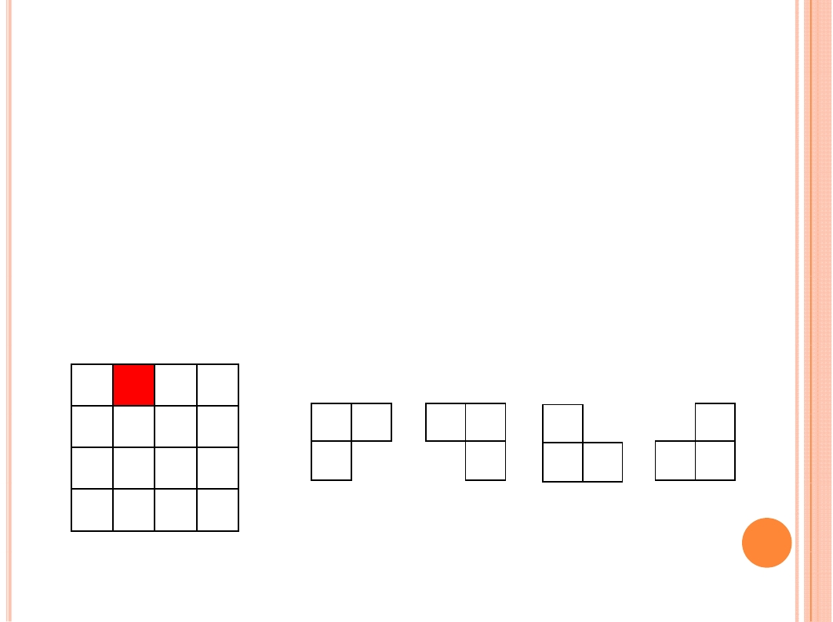
CHESS BOARD COVER
On a 2^{k}× 2^{k} chessboard，only one square is different, called specific.
In the chessboard cover problem, we use the following four kinds of
L-shape cards to cover the whole chessboard squares except the
specific, and request that there is no overlapping.

Slide 83
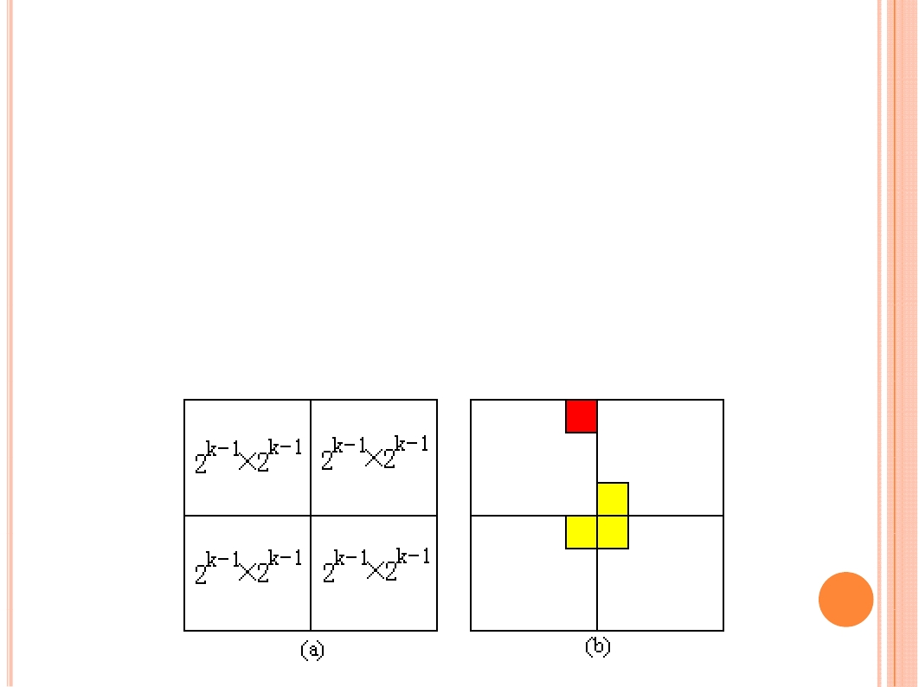
Chessboard Cover
•When k>0， partition 2^{k}× 2^{k} chessboard into four 2^{k-1}× 2^{k-1} sub-chessboard
•The specific must be in one of the four sub-chessboard, and the other three
have no specific.
•Now lay a L-shaped cards on the joint of the three sub-chessboard.
•Then we get four smaller chessboard cover problem.
• Do recursively until we get 1× 1 chessboard。

Slide 84
Chessboard Cover
•When k>0， partition 2^{k}× 2^{k} chessboard into four 2^{k-1}× 2^{k-1} sub-chessboard
•The specific must be in one of the four sub-chessboard, and the other three
have no specific.
•Now lay a L-shaped cards on the joint of the three sub-chessboard.
•Then we get four smaller chessboard cover problem.
• Do recursively until we get 1× 1 chessboard。

Slide 85
Binary Searching
Given n elements arranged in ascending order, find a particular
element K.
Compare the middle element with the particular look up element X, if X is equal to the middle element, then the searching is successful and this algorithm is terminated; if X is less than the middle element, continue the searching in the first half of the sequence; otherwise, continue the searching in the second half of the sequence.

Slide 86
Searching 17 in the sequence [5,8,15,17,25,30,34,39,45,52,60] . Here, variables “low” and “high” stands for the searching scope, “mid” stands for the middle of the searching scope. In fact, mid=(low+high)/2)
0 | 1 | 2 | 3 | 4 | 5 | 6 | 7 | 8 | 9 | 10
5 | 8 | 15 | 17 | 25 | 30 | 34 | 39 | 45 | 52 | 60
low=0
mid=5
high=10

Slide 87
0 | 1 | 2 | 3 | 4 | 5 | 6 | 7 | 8 | 9 | 10
5 | 8 | 15 | 17 | 25 | 30 | 34 | 39 | 45 | 52 | 60
low=0
mid=5
high=10
0 | 1 | 2 | 3 | 4 | 5 | 6 | 7 | 8 | 9 | 10
5 | 8 | 15 | 17 | 25 | 30 | 34 | 39 | 45 | 52 | 60
low=0
mid=2
high=4
0 | 1 | 2 | 3 | 4 | 5 | 6 | 7 | 8 | 9 | 10
5 | 8 | 15 | 17 | 25 | 30 | 34 | 39 | 45 | 52 | 60
mid=3
low=3
high=4
Successfully complete the searching，
terminate the searching algorithm.

